Slide 1
Algorithms
Dynamic Programming

Slide 2
Dynamic programming
Dynamic Programming is a general algorithm design technique
Invented by American mathematician Richard Bellman in the 1950s to solve optimization problems
“Programming” here means “planning”
Main idea:
  set up a recurrence relating a solution to a larger instance to solutions of some smaller instances
  solve smaller instances once
  record solutions in a table
  extract solution to the initial instance from that table

Slide 3
Example: Fibonacci numbers
Recall definition of Fibonacci numbers:
  f(0) = 0
  f(1) = 1
  f(n) = f(n-1) + f(n-2)
Computing the n^{th} Fibonacci number recursively (top-down):
f(n)
f(n-1) + f(n-2)
f(n-2) + f(n-3) f(n-3) + f(n-4)
...

Slide 4
Example: Fibonacci numbers
  Computing the n^{th} Fibonacci number using bottom-up iteration:
f(0) = 0
f(1) = 1
f(2) = 0+1 = 1
f(3) = 1+1 = 2
f(4) = 1+2 = 3
f(5) = 2+3 = 5
f(n-2) =
f(n-1) =
f(n) = f(n-1) + f(n-2)

Slide 5
Examples of dynamic programming algorithms
  Coin-row problem
  Computing binomial coefficients
  coins collection
  Longest Common Subsequence (LCS)
  Some instances of difficult discrete optimization problems:
    0-1 knapsack

Slide 6
Coin-row problem
There is a row of n coins whose values are some positive integers c₁, c₂,...,c_{n}, not necessarily distinct. The goal is to pick up the maximum amount of money subject to the constraint that no two coins adjacent in the initial row can be picked up.
E.g.: 5, 1, 2, 10, 6, 2,
the best selection is 5, 10, 2, giving the maximum amount of 17.

Slide 7
DP solution to the coin-row problem
Let F(n) be the maximum amount that can be picked up from the row of n coins. To derive a recurrence for F(n), we partition all the allowed coin selections into two groups:
those without last coin – the max amount is ?
those with the last coin -- the max amount is ?

Slide 8
DP solution to the coin-row problem
Let F(n) be the maximum amount that can be picked up from the row of n coins. To derive a recurrence for F(n), we partition all the allowed coin selections into two groups:
those without last coin – the max amount is ?
those with the last coin -- the max amount is ?
Thus we have the following recurrence
F(n) = max{c_{n} + F(n-2), F(n-1)} for n > 1,
F(0) = 0, F(1)=c₁

Slide 9
DP solution to the coin-row problem (cont.)
F(n) = max{c_{n} + F(n-2), F(n-1)} for n > 1,
F(0) = 0, F(1)=c₁
index | 0 | 1 | 2 | 3 | 4 | 5 | 6
coins | -- | 5 | 1 | 2 | 10 | 6 | 2
F( ) | 0 | 5 | 5 | 7 | 15 | 15 | 17
Max amount:
Coins of optimal solution:
Time efficiency:
Space efficiency:
Note: All smaller instances were solved.

Slide 10
Computing a binomial coefficient by DP
  Binomial coefficients are coefficients of the binomial formula:
  (a + b)^{n} = C(n,0)a^{n}b⁰ + . . . + C(n,k)a^{n-k}b^{k} + . . . + C(n,n)a⁰b^{n}
  C(n, k), the number of combinations of k elements from an n-element set (0 ≤ k ≤ n)
  Recurrence: C(n,k) = ?

Slide 11
Computing a binomial coefficient by DP
  Binomial coefficients are coefficients of the binomial formula:
  (a + b)^{n} = C(n,0)a^{n}b⁰ + . . . + C(n,k)a^{n-k}b^{k} + . . . + C(n,n)a⁰b^{n}
  C(n, k), the number of combinations of k elements from an n-element set (0 ≤ k ≤ n)
  Recurrence: C(n,k) = ?
  those without last element – the number of such combinations is ?
  those with the last element -- the number of such combinations is ?

Slide 12
Computing a binomial coefficient by DP
  Binomial coefficients are coefficients of the binomial formula:
  (a + b)^{n} = C(n,0)a^{n}b⁰ + . . . + C(n,k)a^{n-k}b^{k} + . . . + C(n,n)a⁰b^{n}
  Recurrence: C(n,k) = C(n-1,k) + C(n-1,k-1) for n > k > 0
  C(n,0) = 1, C(n,n) = 1 for n ≥ 0
  Value of C(n,k) can be computed by filling a table:
  0 1 2 . . . k-1 k
  0 1
  1 1 1
  .
  .
  .
  n-1 C(n-1,k-1) C(n-1,k)
  n C(n,k)

Slide 13
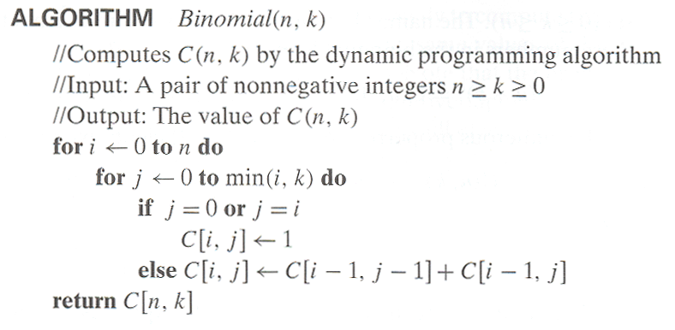
Computing C(n,k): pseudocode and analysis
Time efficiency: ?
Space efficiency: ?

Slide 14
Computing C(n,k): pseudocode and analysis
Time efficiency: Θ(nk)
Space efficiency: Θ(nk)

Slide 15
In-class exercise
  Compute C(6, 3) by applying the dynamic programming algorithm
Design and Analysis of Algorithms - Chapter 8

Slide 16
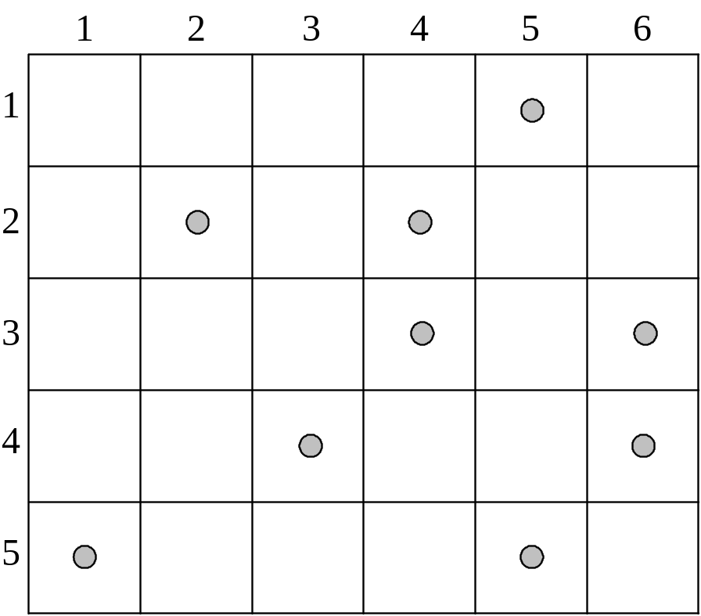
In-Class Exercise
Several coins are placed in cells of an n×m board. A robot, located in the upper left cell of the board, needs to collect as many of the coins as possible and bring them to the bottom right cell. On each step, the robot can move either one cell to the right or one cell down from its current location.

Slide 17
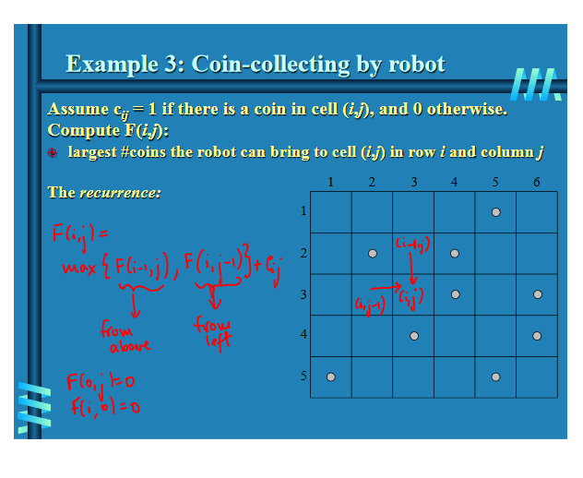
Design and Analysis of Algorithms - Chapter 8

Slide 18
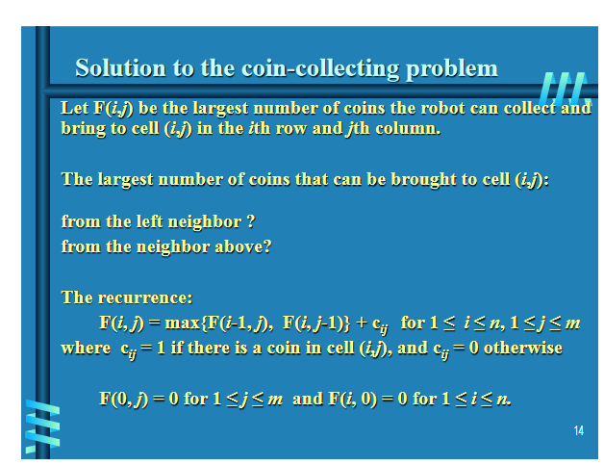
Design and Analysis of Algorithms - Chapter 8

Slide 19
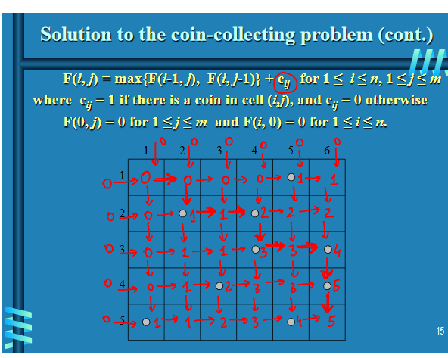
Design and Analysis of Algorithms - Chapter 8

Slide 20
Longest Common Subsequence (LCS)
A subsequence of a sequence/string S is obtained by deleting zero or more symbols from S. For example, the following are some subsequences of “president”: pred, sdn, predent. In other words, the letters of a subsequence of S appear in order in S, but they are not required to be consecutive.
The longest common subsequence problem is to find a maximum length common subsequence between two sequences.

Slide 21
LCS
For instance,
Sequence 1: president
Sequence 2: providence
Its LCS is priden.
president
providence

Slide 22
LCS
        Another example:
Sequence 1: algorithm
Sequence 2: alignment
One of its LCS is algm.
a l g o r i t h m
a l i g n m e n t

Slide 23
How to compute LCS?
Let A=a₁a₂…a_{m} and B=b₁b₂…b_{n} .
len(i, j): the length of an LCS between
a₁a₂…a_{i} and b₁b₂…b_{j}

Slide 24

How to compute LCS?
Let A=a₁a₂…a_{m} and B=b₁b₂…b_{n} .
len(i, j): the length of an LCS between
a₁a₂…a_{i} and b₁b₂…b_{j}
With proper initializations, len(i, j) can be computed as follows

Slide 25
How to compute LCS?
Let A=a₁a₂…a_{m} and B=b₁b₂…b_{n} .
len(i, j): the length of an LCS between
a₁a₂…a_{i} and b₁b₂…b_{j}
With proper initializations, len(i, j) can be computed as follows
What is the corresponding LCS?

Slide 26
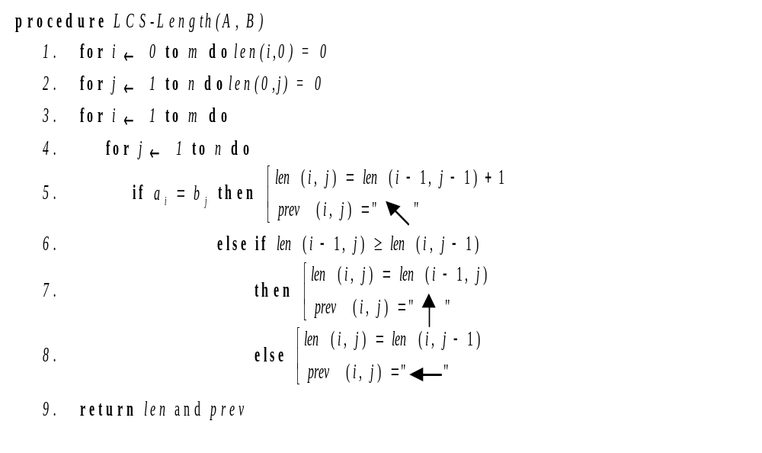

Slide 27
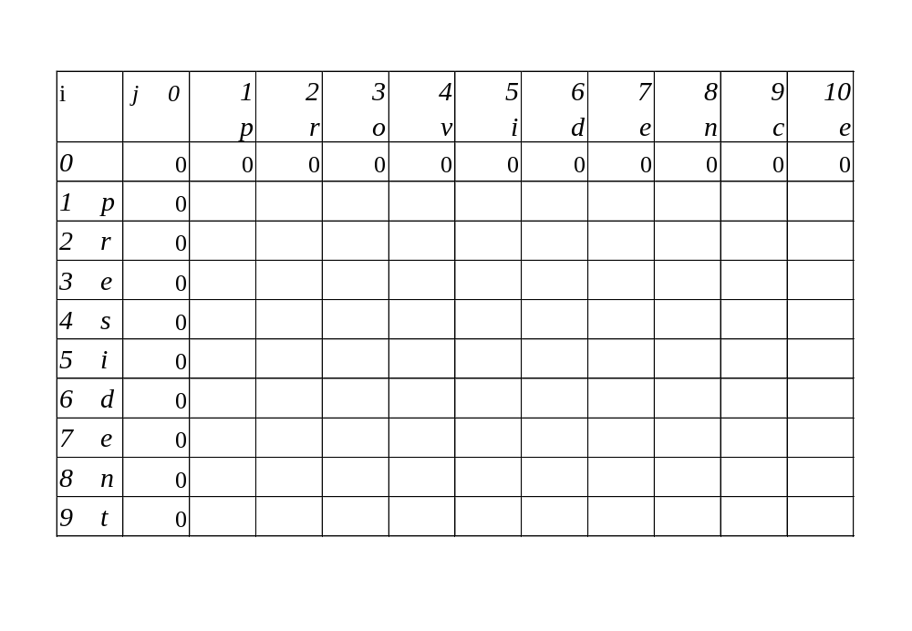
Running time and memory: O(mn) and O(mn).

Slide 28
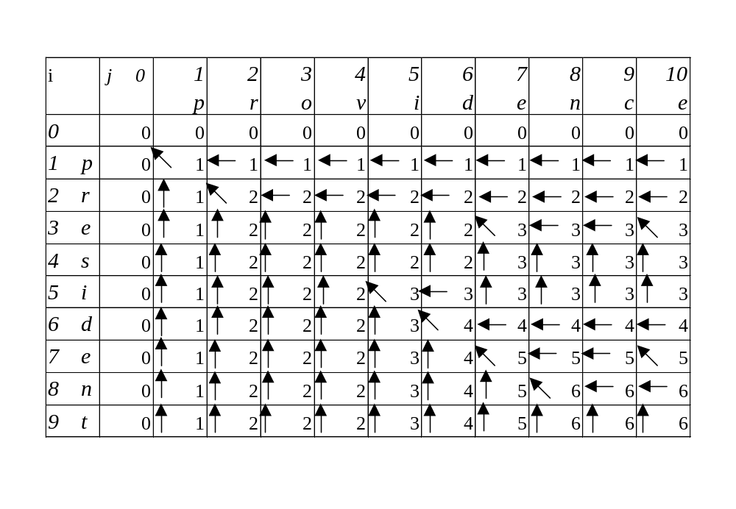
Running time and memory: O(mn) and O(mn).

Slide 29
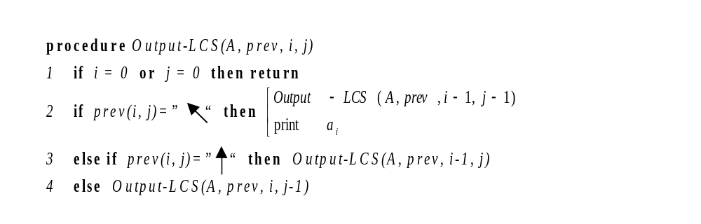
The backtracing algorithm

Slide 30
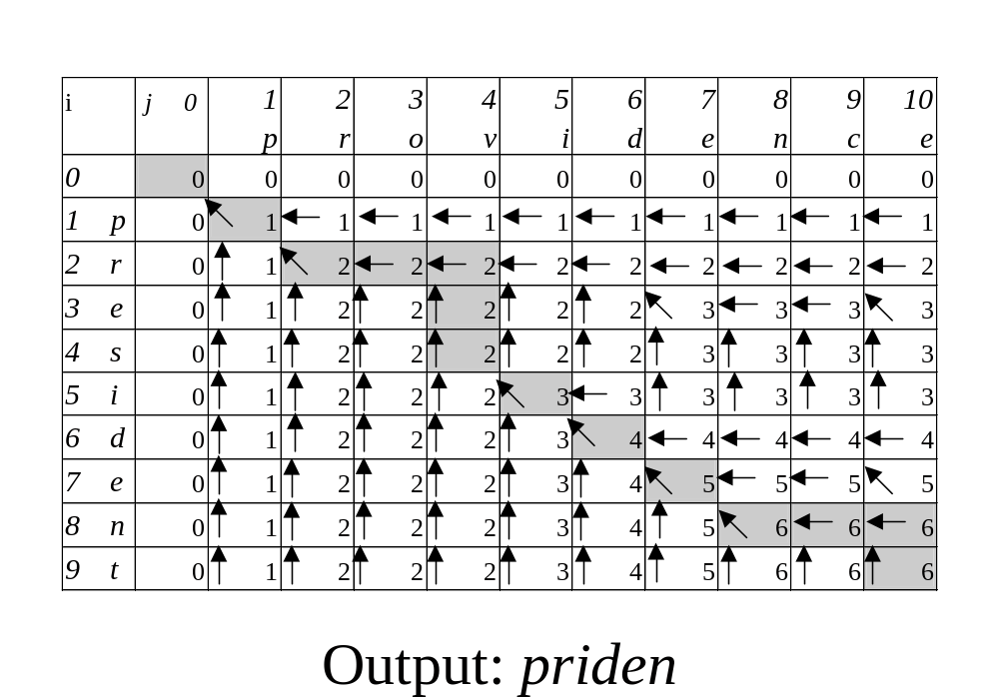

Slide 31
Knapsack Problem by DP
Given n items of
  integer weights: w₁ w₂ … w_{n}
  values: v₁ v₂ … v_{n}
a knapsack of integer capacity W
find most valuable subset of the items that fit into the knapsack
Consider instance defined by first i items and capacity j (j ≤ W).
Let V[i,j] be optimal value of such an instance. Then
max {V[i-1,j], v_{i} + V[i-1,j- w_{i}]} if j- w_{i} ≥ 0
V[i,j] =
V[i-1,j] if j- w_{i} < 0
Initial conditions: V[0,j] = 0 and V[i,0] = 0
{

Slide 32
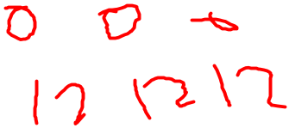
Knapsack Problem by DP (example)
Example: Knapsack of capacity W = 5
item weight value
1 2 $12 max {V[i-1,j], v_{i} + V[i-1,j- w_{i}]}
2 1 $10 V[i-1,j] if j- w_{i} < 0
3 3 $20
4 2 $15 capacity j
0 1 2 3 4 5
0
w₁ = 2, v₁= 12 1
w₂ = 1, v₂= 10 2
w₃ = 3, v₃= 20 3
w₄ = 2, v₄= 15 4 ?
0 0 0
0 0 12
0 10 12
22 22 22
0 10 12 22 30 32
0 10 15 25 30 37
Backtracing finds the actual optimal subset, i.e. solution.

Slide 33
Knapsack Problem by DP (pseudocode)
Algorithm DPKnapsack(w[1..n], v[1..n], W)
var V[0..n,0..W], P[1..n,1..W]: int
for j := 0 to W do
V[0,j] := 0
for i := 0 to n do
V[i,0] := 0
for i := 1 to n do
for j := 1 to W do
if w[i] ≤ j and v[i] + V[i-1,j-w[i]] > V[i-1,j] then
V[i,j] := v[i] + V[i-1,j-w[i]]; P[i,j] := j-w[i]
else
V[i,j] := V[i-1,j]; P[i,j] := j
return V[n,W] and the optimal subset by backtracing
Running time and space: O(nW).

Slide 34
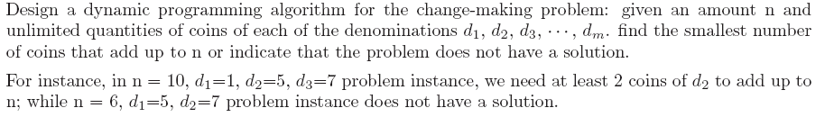
In-class exercise
Design and Analysis of Algorithms - Chapter 8

Slide 35
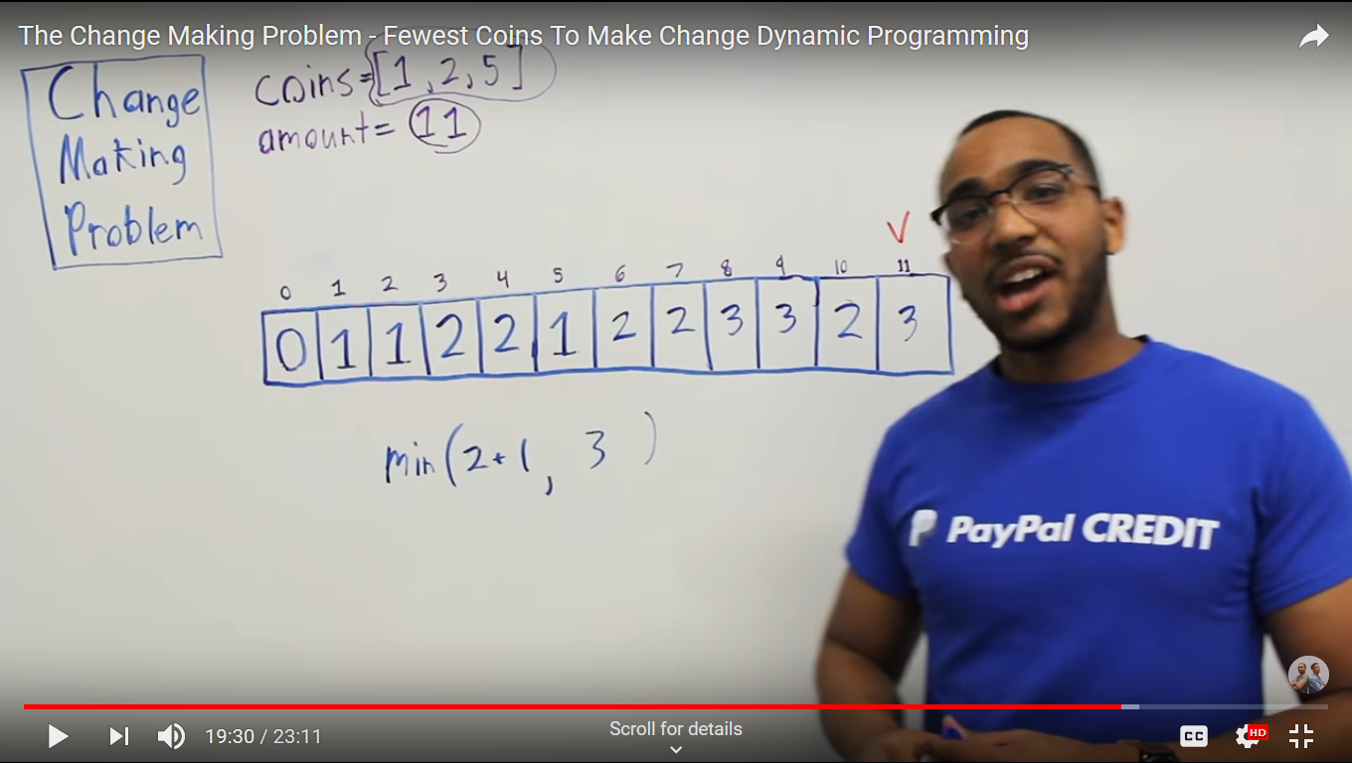
Design and Analysis of Algorithms - Chapter 8

Slide 36
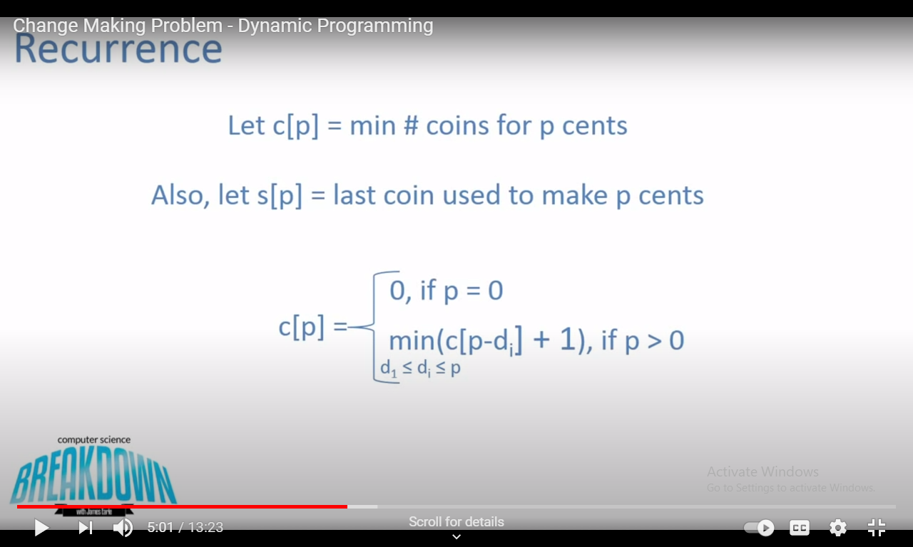
Design and Analysis of Algorithms - Chapter 8

Slide 37
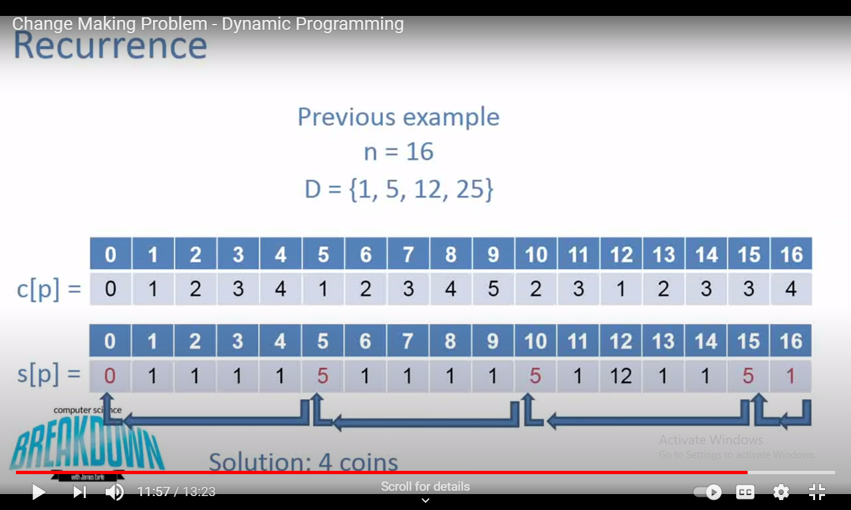
Design and Analysis of Algorithms - Chapter 8

